Slide 1

Vermont Yankee Decommissioning Update
Newport Rotary Club
Joseph R. Lynch
Manager, Government Affairs
Entergy Nuclear Vermont Yankee, LLC (ENVY)
August 4, 2015

Slide 2
VY Current Plant Status & Milestones
Vermont Yankee Nuclear Power Station (VYNPS) ceased power operations on December 29, 2014 after 633 days of continuous power operation – a record for the VY site.
On January 12, 2015, all nuclear fuel was removed from the reactor and placed in the Spent Fuel Pool (SFP).
On January 12, 2015, VYNPS certified to the NRC that the reactor had permanently ceased operations and was permanently defueled.
VYNPS continues to be overseen by the Nuclear Regulatory Commission’s (NRC) as part of its Decommissioning Inspection Program.
The focus of VYNPS and its employees continues to be our ongoing commitment to safety.

Slide 3
Vermont Yankee Timeline
December 29, 2014
Permanent Shutdown
Commercial Operations began in 1972
February 5, 2015
Implement Post-Shutdown Emergency Plan
August 27, 2013
Entergy announces it will cease operations
2020
Implement ISFSI Emergency Plan
April 2016
Implement Permanently Defueled Emergency Plan
2013
2014
2015
2016
2017
2018
2019
2020
SAFSTOR I
September 23, 2013
Entergy submits notification of intent to cease operations to the NRC
SAFSTOR II
ISFSI
January 12, 2015
Fuel permanently removed from reactor vessel

Slide 4
Staffing Transition to Decommissioning
Operation
Dormancy Preparation
SAFSTOR
Defuel
Fuel Cool
Fuel in Dry Storage
Site Operation
Operation Safety
~550 Personnel
1st ISFSI Pad Full; 2nd Pad Needed
Wet Fuel (Hot) Management
~316 Personnel
Wet Fuel (Cool) Management
~127 Personnel
Dry Fuel Management
~58 Personnel
Organizations
Decom Planning
SAFSTOR II
SAFSTOR I

Slide 5
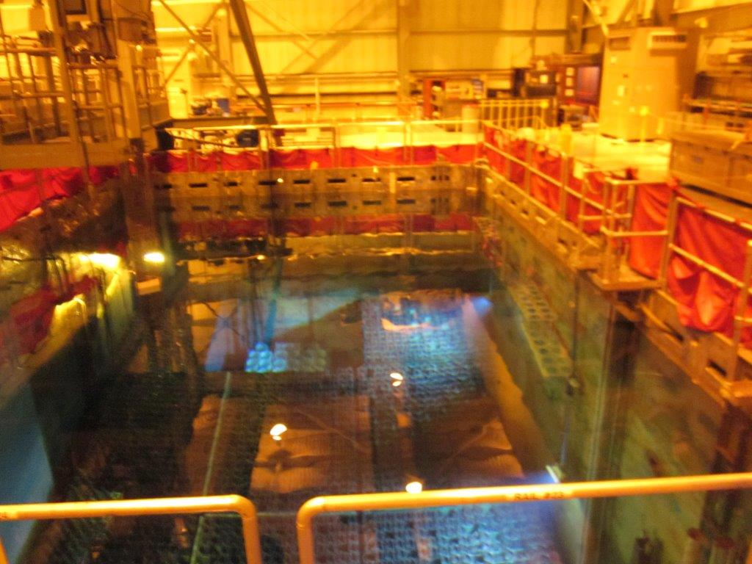
Spent Fuel Management

Slide 6
Current Dry Fuel Storage Status
Thirteen (13) Dry Fuel Storage Casks are safely loaded and stored on the first of two (2) Independent Spent Fuel Storage Installation (ISFSI) pads.
Application for a second ISFSI pad was submitted on June 30, 2014 to the Vermont Public Service Board (PSB) seeking a Certificate of Public Good (CPG). Approval expected in May 2016
An additional forty-five (45) Dry Fuel Storage Casks for a total of
fifty-eight (58) will be loaded and stored on the two pads.
Current plan is to transfer all spent fuel to Dry Cask Storage by 2020.

Slide 7
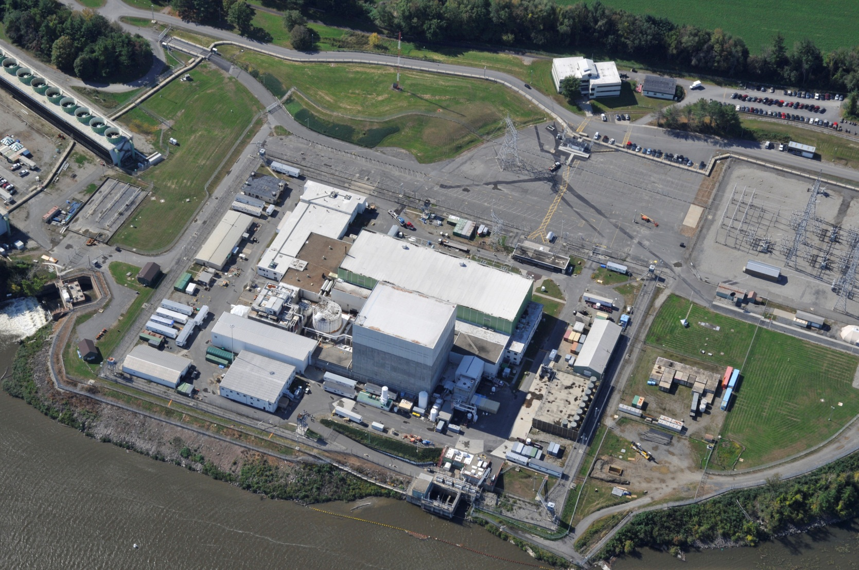
Independent Spent Fuel Storage Installation (ISFSI)

Slide 8
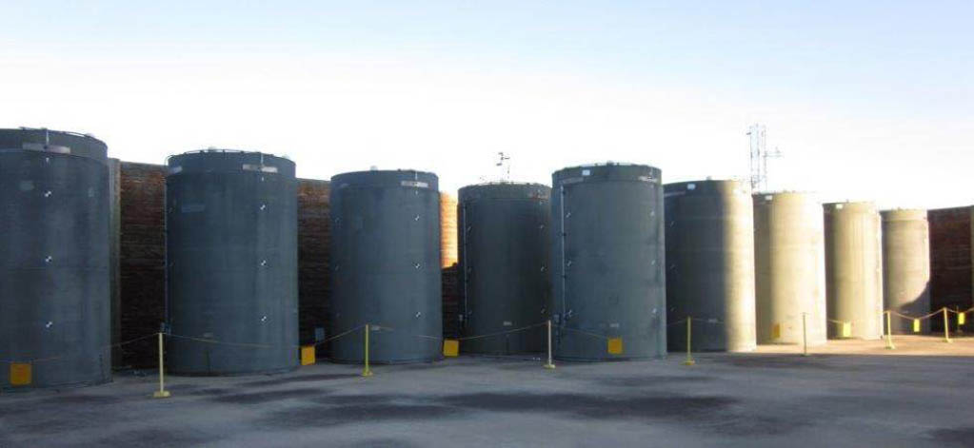
Independent Spent Fuel Storage Installation (ISFSI)

Slide 9
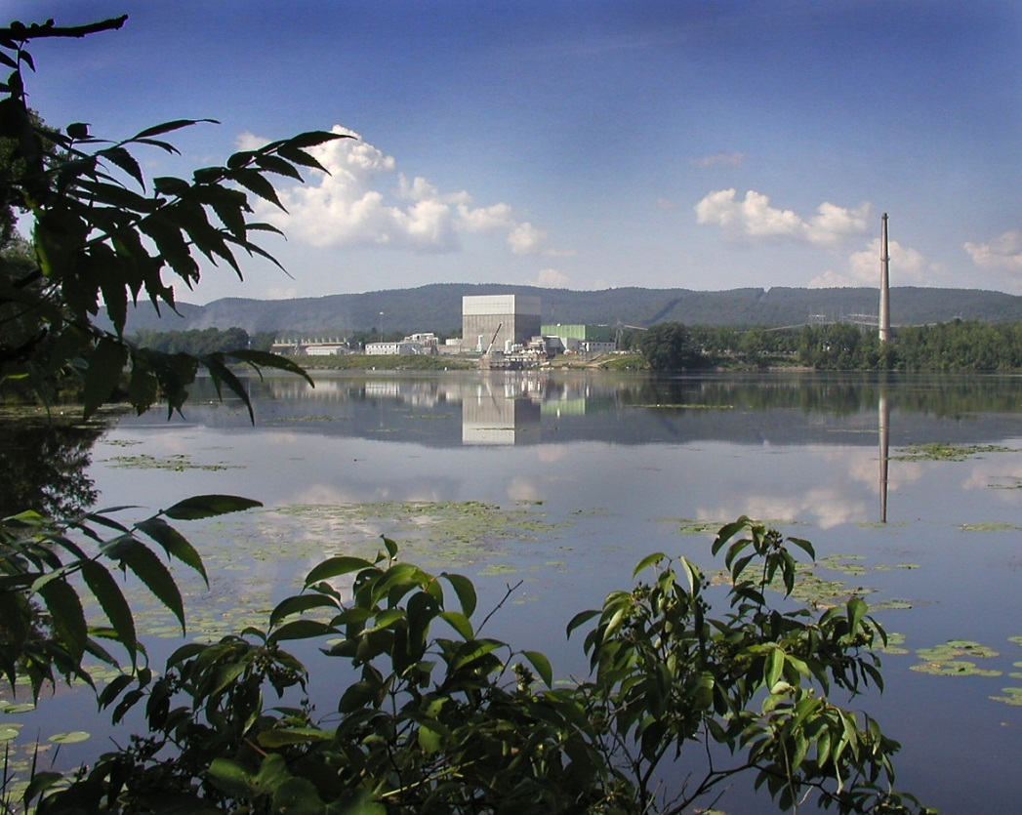
Decommissioning Cost Estimate

Slide 10
Decommissioning Cost Estimate and Nuclear Decommissioning Trust (NDT)
Updated Cost Estimate to Decommission VYNPS is $1.242 Billion in 2014 dollars for SAFSTOR.
  Termination of the NRC Operating License - $817 Million
  Site Restoration - $57 Million
  Spent Fuel Management - $368 Million
Spent Fuel Management - $368 Million
  Operational costs - $225 Million
  Transfer to dry storage - $143 Million
    To fund “transfer to dry storage”, ENVY established two (2) credit lines totaling $145 Million
    Reduces Spent Fuel Management impact to NDT

Slide 11
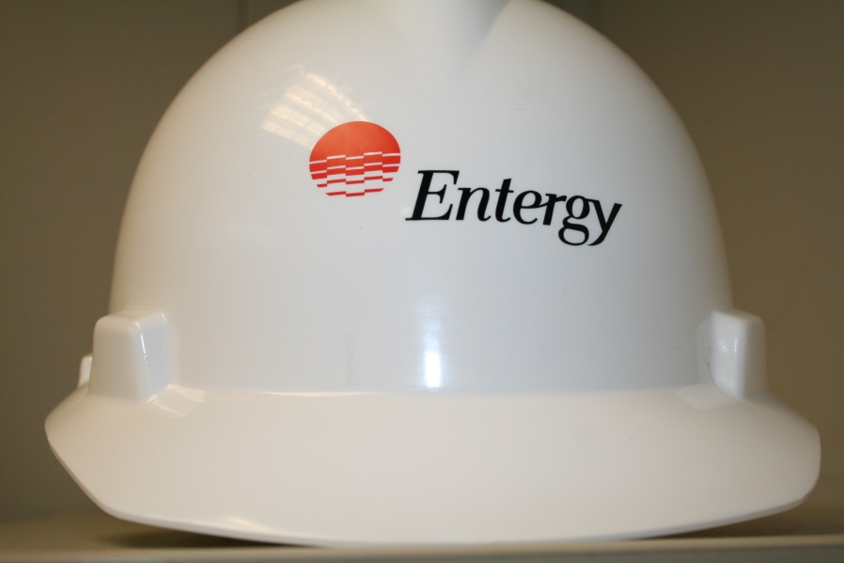
Decommissioning Project Status/Issues

Slide 12
VY Decommissioning Update
The focus of Entergy Vermont Yankee (VY) and its Employees continues to be our ongoing commitment to Safety.
Decommissioning Preparation Activities
  System Draining/Lay-Up
  Building Power and Services Removal - Ongoing
  Security Modifications/Enhancements Ongoing
Completed Select Structure/Building Removal
Emergency Plan Drill – June 10, 2015
  Part of ongoing training and Emergency Response Organization (ERO) qualifications.
Completion of Second ISFSI Pad and Transfer of Remaining Spent Fuel from Pool to Pad

Slide 13
VY Decommissioning Update (Cont’d)
The focus of Entergy Vermont Yankee (VY) and its Employees continues to be our ongoing commitment to Safety.
Vermont State Agency Interactions
  Agency of Natural Resources (ANR)
    Since March, 2015, follow-up to Site Assessment Study (SAS) and recent work at the site
    Site Inspection on May 18, 2015 noted minor issues with labeling, waste characterization and inventory records. Subsequently corrected.
    Received a Notice of Alleged Violation from ANR with a response due in September. All issues have been corrected.
  Department of Health (VDH)
    Response to April 2, 2015 Request For Information (RFI) provided to VDH on April 22, as well as invitation for face-to-face meeting to discuss any questions.
    No response from VDH to date.

Slide 14
VY Decommissioning Update (Cont’d)
The focus of Entergy Vermont Yankee (VY) and its Employees continues to be our ongoing commitment to Safety.
Vermont State Agency Interactions
  Public Service Board (PSB)
    Status Conference held before the PSB on April 29, 2015 to discuss Docket No. 8300 seeking a Certificate of Public Good (CPG) authorizing the construction of a 2nd ISFSI pad and related improvements including installation of a new 200 kW diesel generator.
    PSB issued a Scheduling Order on May 6, 2015.
    Public Hearing was conducted on June 4, 2015.
    Intervention was granted to NEC, WRC and the Town of Vernon.
    Approval expected in May of 2016.

Slide 15
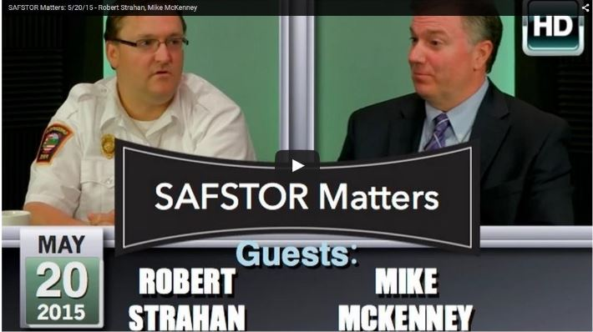

Open Communication and Transparency
Nuclear Decommissioning Citizens Advisory Panel (NDCAP)
Stakeholder Outreach: Speaking Engagements, Community Involvement, and Facility Tours
SAFSTOR Matters – Monthly Cable TV Show
Vermont Yankee Decommissioning website:
www.vydecommissioning.com

Slide 16

Questions?
Joseph R. Lynch
Manager, Government Affairs
Entergy Nuclear Vermont Yankee, LLC (ENVY)
Work: (802)-258-4107
Cell: (508)-728-1421
Email: jlynch4@entergy.com

