Slide 1
Nuclear Decommissioning Citizens Advisory Panel (NDCAP)
September 24, 2015

Slide 2
Introductions
Joseph Lynch
Government Affairs Manager,
Entergy Vermont Yankee (ENVY)

Slide 3
VY Decommissioning Update The focus of Entergy Vermont Yankee (VY) and its Employees continues to be our ongoing commitment to Safety.
Decommissioning Preparation Activities
System Draining/Lay-Up (50 Systems/16 Complete/5 In Progress)
Building Power and Services Removal – Ongoing
Security Plan Changes
Phase 1 and Phase 2 Modifications - Complete
Emergency Plan Drill – October 21, 2015
Part of ongoing training and Emergency Response Organization (ERO) qualifications.
NRC Inspection Activities
On-Site Inspection completed the week of 9/14-9/17
Inspection scope informed by the NRC Decommissioning Program
Debriefed with no issues identified

Slide 4
VY Decommissioning Update (Cont’d) The focus of Entergy Vermont Yankee (VY) and its Employees continues to be our ongoing commitment to Safety.
NRC Licensing Action/Exemption Status
Emergency Plan (E-Plan) Submittals made to date:
Post-Shutdown E-Plan License Amendment Request (LAR) – Implemented 2/5/15. Covers SAFSTOR Period 1 - Plant Shutdown to April 2016
State filed appeal to Commission to keep ERDS in service – February 9, 2015
Commission decision – 4Q15 to 1Q16 (6-12 months)
EP Exemption Requests – NRC Commissioners voted to grant exemptions on March 2, 2015 (supports Permanently Defueled E-Plan and EALs)
State filed petition for reconsideration of Commission vote – March 12, 2015
Commission decision on petition for reconsideration – 4Q15 (6)
Permanently Defueled E-Plan and Emergency Action Levels (EALs) LAR – Approval requested in late 2015. Covers SAFSTOR Period 2 - April 2016 to All Fuel in Dry Storage
State filed petition to intervene/request for hearing before the ASLB – February 9, 2015
ASLB decision denying request for hearing – May 18, 2015
State appeal of ASLB decision to NRC Commission – June 12, 2015
Commission decision – 1Q16 to 2Q16 (6-12 months)

Slide 5
Vermont Yankee Timeline
Commercial Operations began in 1972
December 29, 2014
Permanent Shutdown
February 5, 2015
Implement Post-Shutdown Emergency Plan
August 27, 2013
Entergy announces it will cease operations
2020
Implement ISFSI Emergency Plan
April 2016
Implement Permanently Defueled Emergency Plan
2013
2014
2015
2016
2017
2018
2019
2020
SAFSTOR I
September 23, 2013
Entergy submits notification of intent to cease operations to the NRC
SAFSTOR II
ISFSI
January 12, 2015
Fuel permanently removed from reactor vessel

Slide 6
VY Decommissioning Update (Cont’d) The focus of Entergy Vermont Yankee (VY) and its Employees continues to be our ongoing commitment to Safety.
Emergency Plan Funding – SAFSTOR II
Commensurate with reduced risk and events limited to Spent Fuel storage.
Consistent with the Permanently Defueled E-Plan and new Emergency Action Levels (EALs).
Offsite emergency measures are consistent with all hazards planning approach
Emergency Planning Zones (EPZ)
Within Plant Site Boundary commensurate with risk
Unusual Event and Alert Classifications
Focused on local support, populations and a declining funding scale.
State of NH recently signed to a 4-year agreement (FY17-FY20) for a total cost of $279K (EP and DOH)
ENVY has been contacted by MA to discuss long-term EP funding.

Slide 7
VY Decommissioning Update (Cont’d) The focus of Entergy Vermont Yankee (VY) and its Employees continues to be our ongoing commitment to Safety.
NRC Licensing Action/Exemption Status
Nuclear Decommissioning Trust (NDT) License Amendment Request (LAR)
Entergy filed this LAR to change the current requirement in the ENVY Operating License for providing NRC a 30-day notification prior to withdrawals to the NDT.
State filed petition to intervene/request for hearing before the ASLB – April 20, 2015
State filed motion to add new and amend existing contentions – July 6, 2015
ASLB decision to allow hearing request for 2 of 5 contentions – July 31, 2015
After a review of options, EVY has decided to withdraw the LAR.
ENVY will continue to comply with its existing license conditions and will continue to provide notifications to the NRC at least 30 days in advance of any withdrawals from the trust fund.
Commingled Funds Exemption
Approved and issued by the NRC - June 17, 2015
State, GMP and VYNPC petitioned the D.C. Circuit for review of NRC’s issuance of the commingled funds exemption – August 13, 2015
Entergy filed a motion to intervene – September 2, 2015

Slide 8
VY Decommissioning Update (Cont’d) The focus of Entergy Vermont Yankee (VY) and its Employees continues to be our ongoing commitment to Safety.
Vermont State Agency Interactions
Public Service Board (PSB) – Second ISFSI Pad CPG
Filed supplemental pre-filed testimony in May 2015 to explain results of additional soil analyses, update pad construction schedule, revise plans for security diesel generator, and revise dry storage funding plan.
Intervention was granted to New England Coalition (NEC), Windham Regional Commission (WRC),and the Town of Vernon.
PSB issued order limiting scope of NEC’s, WRC’s, and Vernon’s participation in proceeding in July 2015.
Impacts on the local environment,
The reuse of the Vermont Yankee property,
Regional planning, and
Aesthetics.
Completed first two rounds of discovery in July 2015.
Pre-filed testimony received from DPS, ANR, WRC, and NEC in August
Entergy discovery requests issued to ANR and WRC on September 2, 2015

Slide 9
VY Decommissioning Update (Cont’d) The focus of Entergy Vermont Yankee (VY) and its Employees continues to be our ongoing commitment to Safety.
Vermont State Agency Interactions
Public Service Board (PSB) – Second ISFSI Pad CPG (Con’t)
Entergy filed an Objection to Admission of Pre-filed Testimony of Mr. Ray Shadis on Behalf of NEC – September 18, 2015. The basis for the Objection:
Addresses issues that are irrelevant to the CPG proceeding;
Exceeds the limited scope of intervention allowed by the PSB; and
Addresses areas that are preempted by federal law.
Responses to Entergy’s discovery requests due – September 30, 2015
Approval expected in May 2016.
Department of Health (VDH)
Response to April 2, 2015 Request For Information (RFI) provided to VDH on April 22nd, regarding questions on lead and asbestos as well as offer to meet to discuss any questions.

Slide 10
VY Decommissioning Update (Cont’d) The focus of Entergy Vermont Yankee (VY) and its Employees continues to be our ongoing commitment to Safety.
Vermont State Agency Interactions
ANR/Department of Environmental Conservation – Waste Management
Site Visit/Inspection on May 18, 2015 noted issues/observations with labeling, waste characterization and inventory records.
Received a Notice of Alleged Violation (NOAV) from ANR with a 35-day response provided on September 9th. All issues have been corrected.
Received letter from ANR Waste Management & Prevention Division on July 31, 2015 seeking written assurance that ENVY will comply with the Vermont Hazardous Waste Management Regulations (VHWMR).
ENVY has and will continue to be compliance with all State of Vermont Regulations.
ANR – River Corridor & Floodplain Protection Program
New State program (effective March 2015) that regulates new development in flood hazard areas and river corridors.
ANR has been consulted by ENVY for applicability of the regulations as it pertains to the second ISFSI pad because it is new development may be located within the Connecticut River corridor.

Slide 11
Communication and Outreach
Nuclear Decommissioning Citizens Advisory Panel (NDCAP)
Stakeholder Outreach: Speaking Engagements, Community Involvement, and Facility Tours
SAFSTOR Matters – Monthly Cable TV Show
Vermont Yankee Decommissioning website: www.vydecommissioning.com

Slide 12
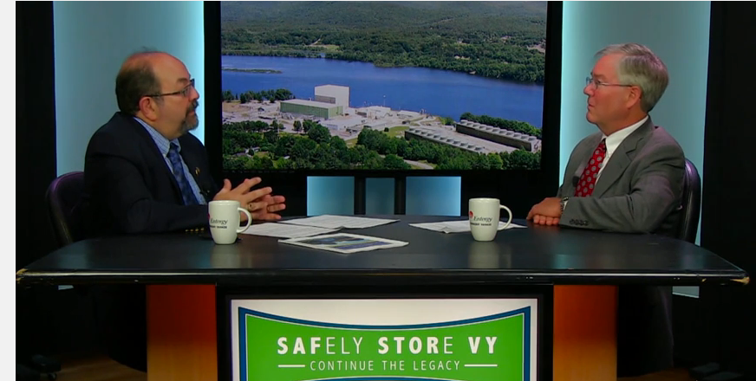
Communication and Outreach (Cont’d)
SAFSTOR Matters – Monthly Cable TV Show
Episode 6 – Maine Yankee Public & Government Relations Manager, Eric Howes - Decommissioning process at Maine Yankee

